Slide 1
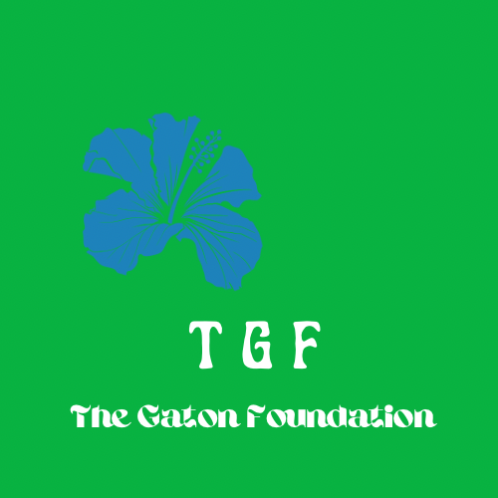
thegatonfoundation.org | thegatonfoundation@gmail.com | @thegatonfoundation Media Kit ’23

Slide 2
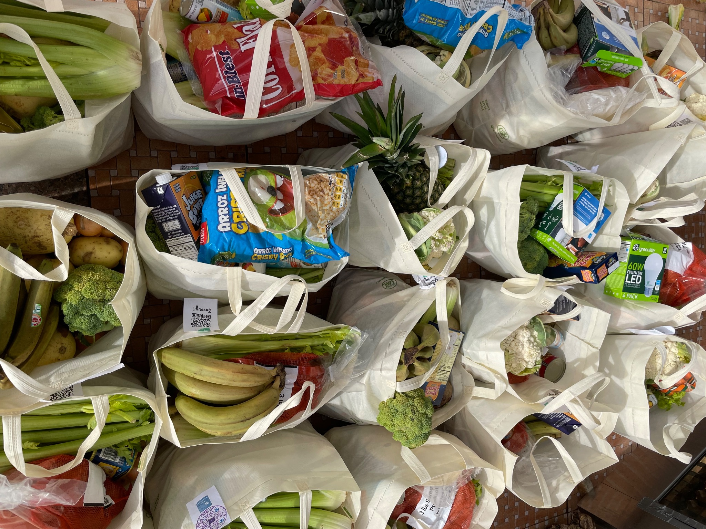
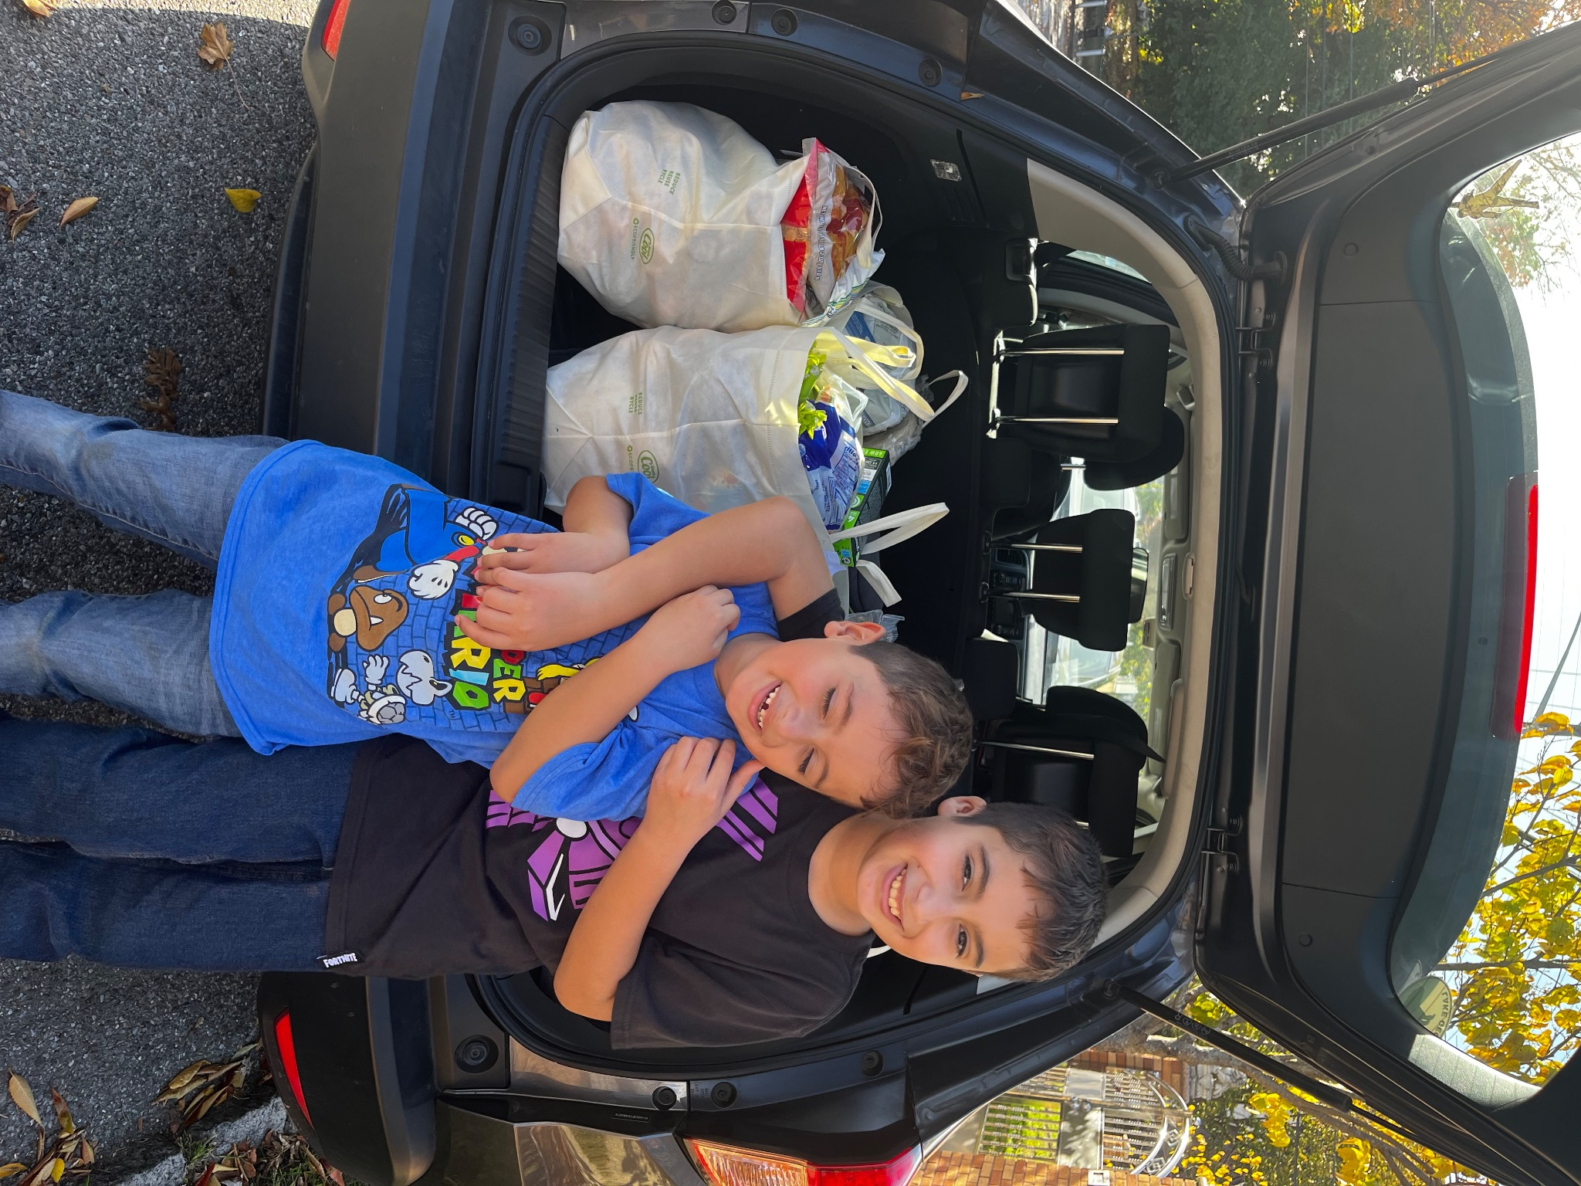
 |  | About US
 |  | The Gaton Foundation is an impact company founded on compassion, and the multiplicity of causal pathways to wellbeing. We aim to support community by inspiring optimism, connection, access, social health, and wellness (in all forms.) Through our programs, projects, and partnerships, we will endeavor to provide solutions for the superabundance of waste, information scarcity, and wellness deficiencies at scale. We are woman founded and led.
thegatonfoundation.org | thegatonfoundation@gmail.com | @thegatonfoundation Media Kit ’23

Slide 3
Give&Go Project Stats!
4 Resource Partners
350-500 Families served monthly
200+ Tons of food delivered to families in need
100+ Volunteers
thegatonfoundation.org | thegatonfoundation@gmail.com | @thegatonfoundation Media Kit ’23

Slide 4
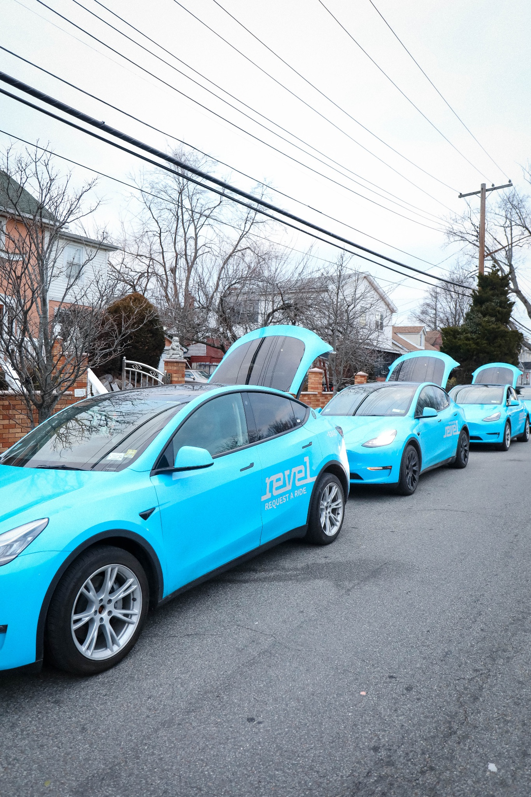

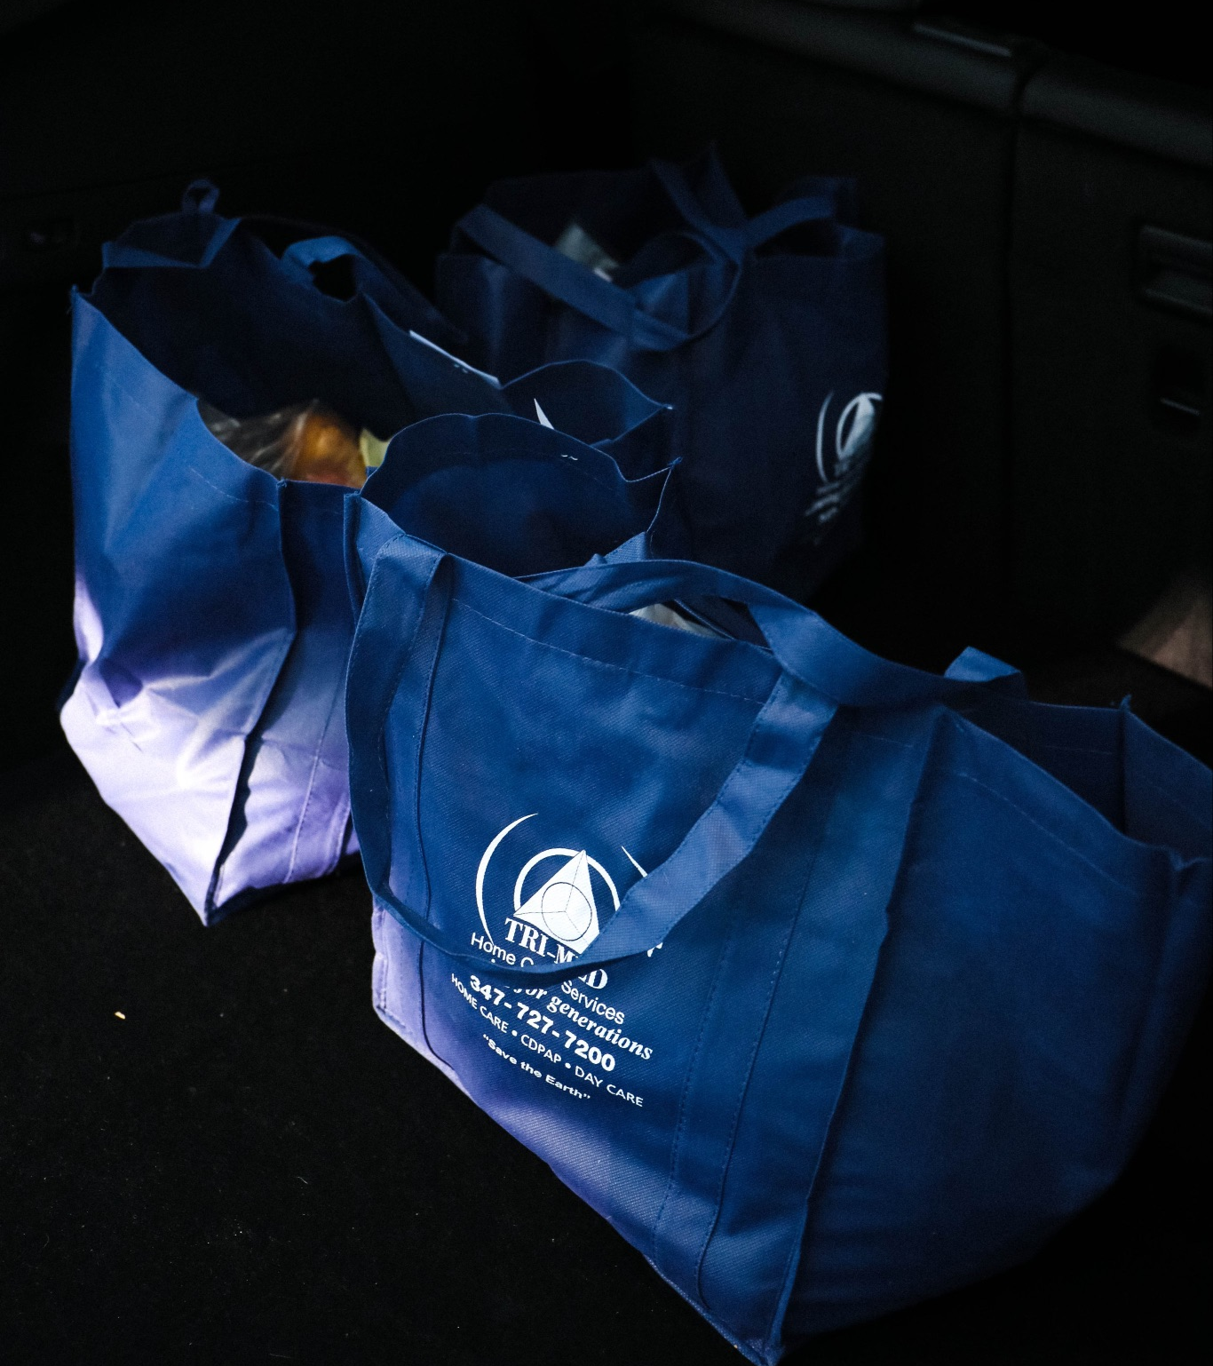

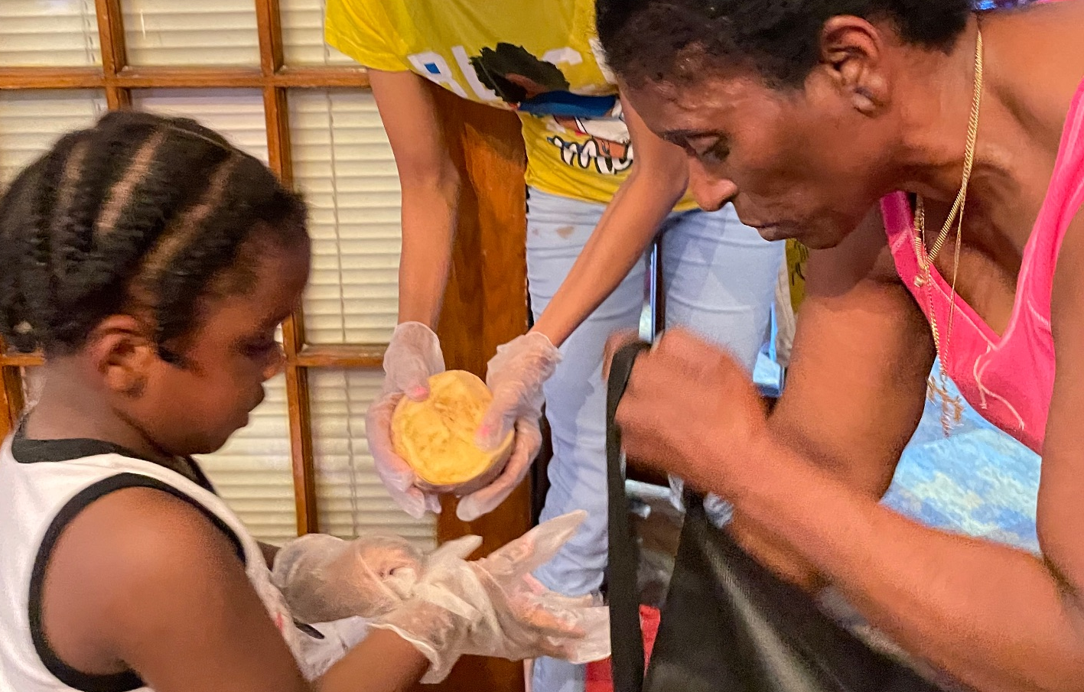
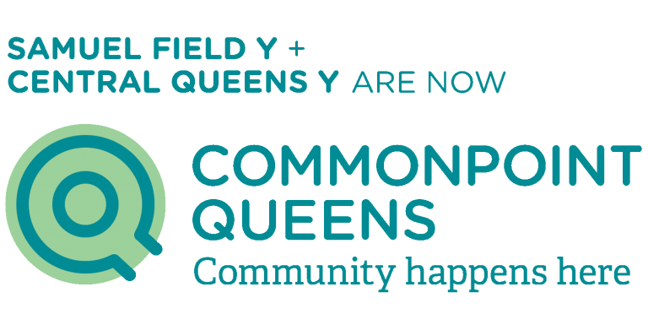

Partnerships & Collaborations
& Mannan Supermarkets
Partnered with us to help increase the reach of TGF’s Give&Go Grocery Project!
They provide groceries for our Give &Go Pop-Ups, a holiday grocery giveaway event hosted by RHHS.
Driving the work forward through emissions-free grocery deliveries to our recipients.
thegatonfoundation.org | thegatonfoundation@gmail.com | @thegatonfoundation Media Kit ’23

Slide 5
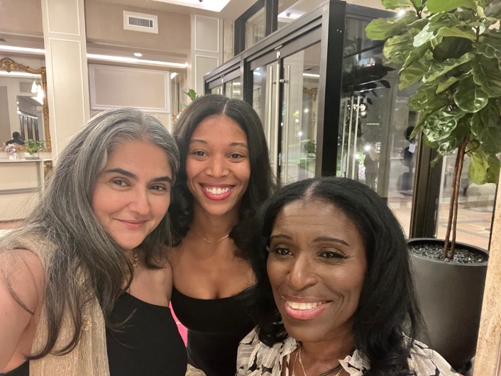
Leadership
Aparna Tambar, LSW
(Pictured left)
TGF Data Architect and member of the board
Angela Gaton-Wiltshire,
MS, MS, MA, MS
(Pictured right)
Co-Founder and President of the board
Kristen Wiltshire, BCHN, BSNS, PDC,
(Pictured center)
Co-Founder and CEO
thegatonfoundation.org | thegatonfoundation@gmail.com | @thegatonfoundation Media Kit ’23

Slide 6
This feels like purpose, building programs that enhance community ecosystems inside and outside of the home.
- Kristen Wiltshire, CEO
thegatonfoundation.org | thegatonfoundation@gmail.com | @thegatonfoundation Media Kit ’23

Slide 7
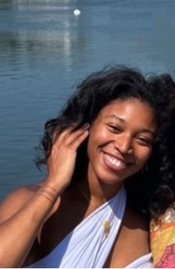
About Kristen Wilshire
Kristen Wiltshire is a multi-passionate Board-Certified Holistic Nutritionist, creative, world traveler, entrepreneur, and philanthropist based in New York City. In 2022, she co-founded The Gaton Foundation, a 501 (c) (3) nonprofit, where she serves as CEO. The organization creates compassionate-impact programs aimed at fostering well-being, reaching over 500 people monthly under her leadership. Kristen envisions integrity-driven collaborations that serve a meaningful purpose, demonstrating her commitment to impactful initiatives.
Find an extended bio on the next slide →
thegatonfoundation.org | thegatonfoundation@gmail.com | @thegatonfoundation Media Kit ’23

Slide 8
Kristen’s Extended Bio
Kristen Wiltshire is a multi-passionate Board-Certified Holistic Nutrition Professional, creative, world traveler, entrepreneur, and burgeoning philanthropist living in New York City. She was a fashion stylist for 7 years, dressing clients and models for print editorials, e-commerce, and advertising for Campbell's Soup and Bloomberg Media. Traveling to and living in India, she became the food designer for Banyan Roots, a company on a mission to connect rural organic farmers with the Rajasthani marketplace. Her service with Global Brigades as a volunteer in public health, gravitational water, and agricultural projects in Honduras, Nicaragua, and Panama catalyzed her interest in international relations. She has since traveled to over 30 countries, learning about agriculture, food politics, and public health. She has a culinary science and art background from studying at Drexel University in Philadelphia, a BSNS in Human Nutrition, and is a certified permaculture designer. Kristen was welcomed into the National Society for Leadership and Success (NSLS) after maintaining a 4.0 GPA and the chancellor's list designation at Purdue. In 2022, Kristen and her mother founded The Gaton Foundation, a 501 (c) (3) nonprofit, and Kristen is the CEO and Chief Creative. The organization develops compassionate impact programs to create pathways to well-being. Under her direction, the project scaled its initial offering to reach over 350 people monthly. As the chief executive, Kristen has initiated a companion project called Regen Compost, which directs the organization's waste to NYRP community gardens and turns it into compost to grow produce for community members. She supports the community fridge project through monthly donations of hundreds of pounds to help feed people in need. Kristen is working on her board certification in holistic nutrition and developing her wellness consultancy, YouRx, which harnesses human biological science to help people optimize their health and performance through plant-forward nutrition. She develops educational resources and healthy recipes, which are donated and distributed to recipients of her foundation's Give&Go Grocery Project. This is all only surpassed by her aims, which include building wellness spaces that contribute to the ecological health of the planet through applied holistic thinking. Kristen imagines integrity integrations for her businesses that serve a purpose through collaboration, and she is excited about expanding her capacity through global learning and transformative service.
thegatonfoundation.org | thegatonfoundation@gmail.com | @thegatonfoundation Media Kit ’23

Slide 9
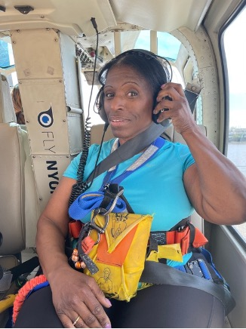
About Angela Wilshire
Angela has been an educator for 36 years. As a bilingual speech and language therapist and education evaluator, she has been instrumental in the lives of thousands of students throughout her career. She is passionate about helping students reach their full academic and socio-emotional development potential.Angela dreamt up the Give&Go project in 2020 after hearing that a fire displaced students attending the high school where she is tenured. She is deeply committed to the growth of this project and seeing it made available to “everyone, everywhere, who can possibly need it.” Angela is the co-founder of The Gaton Foundation and its esteemed board president.
Find an extended bio on the next slide →
thegatonfoundation.org | thegatonfoundation@gmail.com | @thegatonfoundation Media Kit ’23

Slide 10
Angela’s Extended Bio
Angela Gaton-Wiltshire has been an educator for over 36 years. As a bilingual speech and language therapist and education evaluator, she has been instrumental in the lives of thousands of students throughout her career. As a student, she was interested in medicine, attending podiatry school before changing course to education. An Alum of Adelphi University with four Master's degrees in general education, speech and language pathology, deaf education, special education, and permanent certifications in: Mathematics 7-12, Bilingual Education (Elementary) Permanent Extension, Deaf And Hearing Impaired, Special Education, Bilingual Education (Non-Elementary/Elementary), Biology 7-12, School District Administrator, Speech And Hearing Handicapped, English To Speakers Of Other Languages, Nursery, Kindergarten & Grades 1-6, School Administrator/Supervisor. The trajectory of her career in the DOE and in Early Intervention was set. Working at the individual level with children, parents, and guardians to identify challenges that may prevent them from achieving their aspirations gave her purpose. She is passionate about helping students reach their full academic and socio-emotional development potential. Acknowledgments from her colleagues in every institution she’s worked in do not begin to describe her inherent altruism. The proud mother of four has been recognized by the directors of her children's education centers for “unselfish loyalty” to their programs. Angela dreamt up the Give&Go project in 2020 after hearing that a fire displaced students attending the high school where she is tenured. She is deeply committed to the growth of this project and to making it available to “everyone, everywhere, who can possibly need it.” Angela is the co-founder of The Gaton Foundation and its esteemed board president. Those who know her know that her ideas flow freely and that this visionary builds on a lifelong legacy through her work ethic and dedication to philanthropic causes near and far. She embodies the “Giver” spirit, a term she and her team use to identify the volunteers who devote their time, resources, or energy to fortifying the foundations' initiatives. She said, "Children are our greatest opportunity to make an impact. They're curious, imaginative, and have all the components of real change-makers, so we started there by providing the Give&Go Grocery Project to schools. If we can sufficiently nourish people with nutritious foods, education, and opportunities, they can be tremendous forces for good in every connection they make."
thegatonfoundation.org | thegatonfoundation@gmail.com | @thegatonfoundation Media Kit ’23

Slide 11
Contact Us
thegatonfoundation.org
thegatonfoundation@gmail.com
@thegatonfoundation
thegatonfoundation.org | thegatonfoundation@gmail.com | @thegatonfoundation Media Kit ’23

